Slide 1
A Hidden World of Scientific Stories (Or, my experiences with science communication)
Colleen M. Iversen
Climate Change Science Institute and Environmental Sciences Division, Oak Ridge National Laboratory
www.colleeniversen.com @Colleen_Iversen

Slide 2
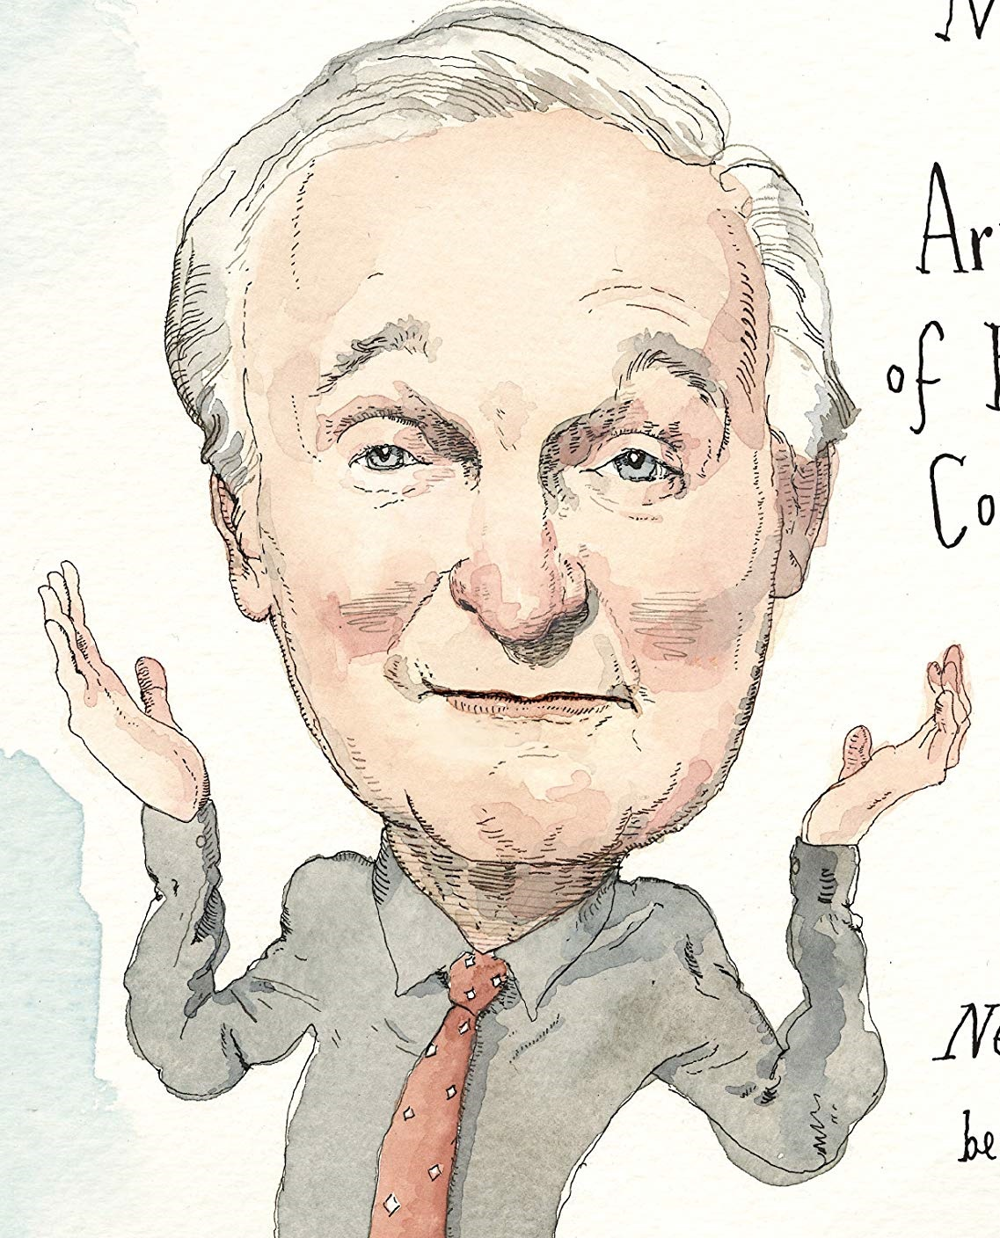
Notes:
Today I’m going to tell you a story about my experiences with science communication.
For me, any talk on science communication starts here, with Alan Alda.

Slide 3
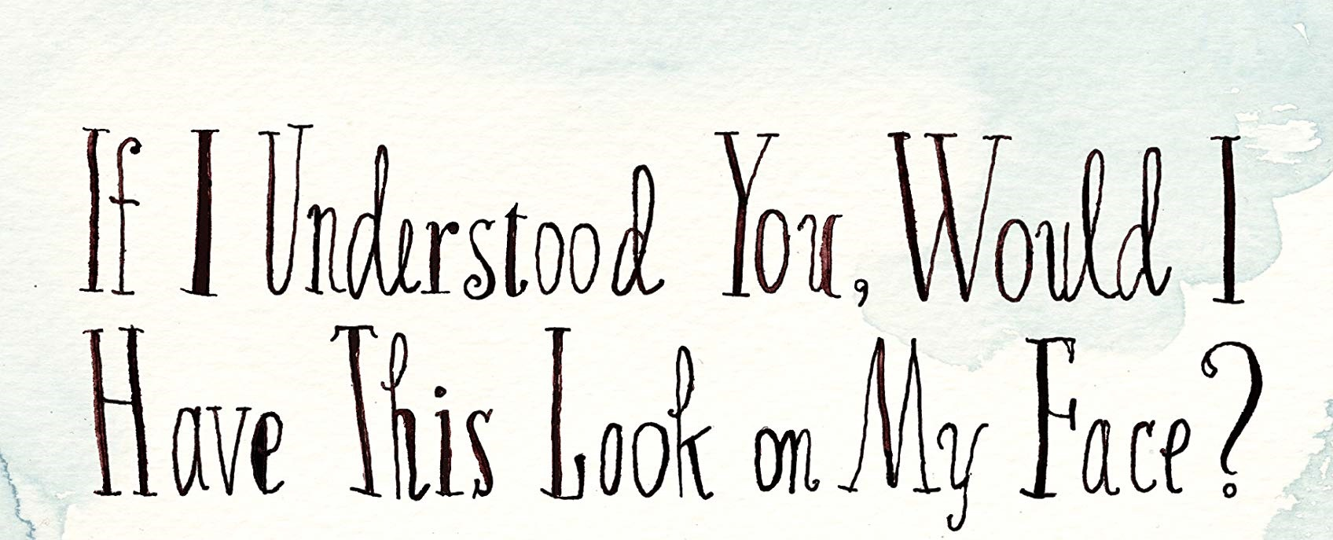
Notes:
For me, any talk on science communication starts here.

Slide 4
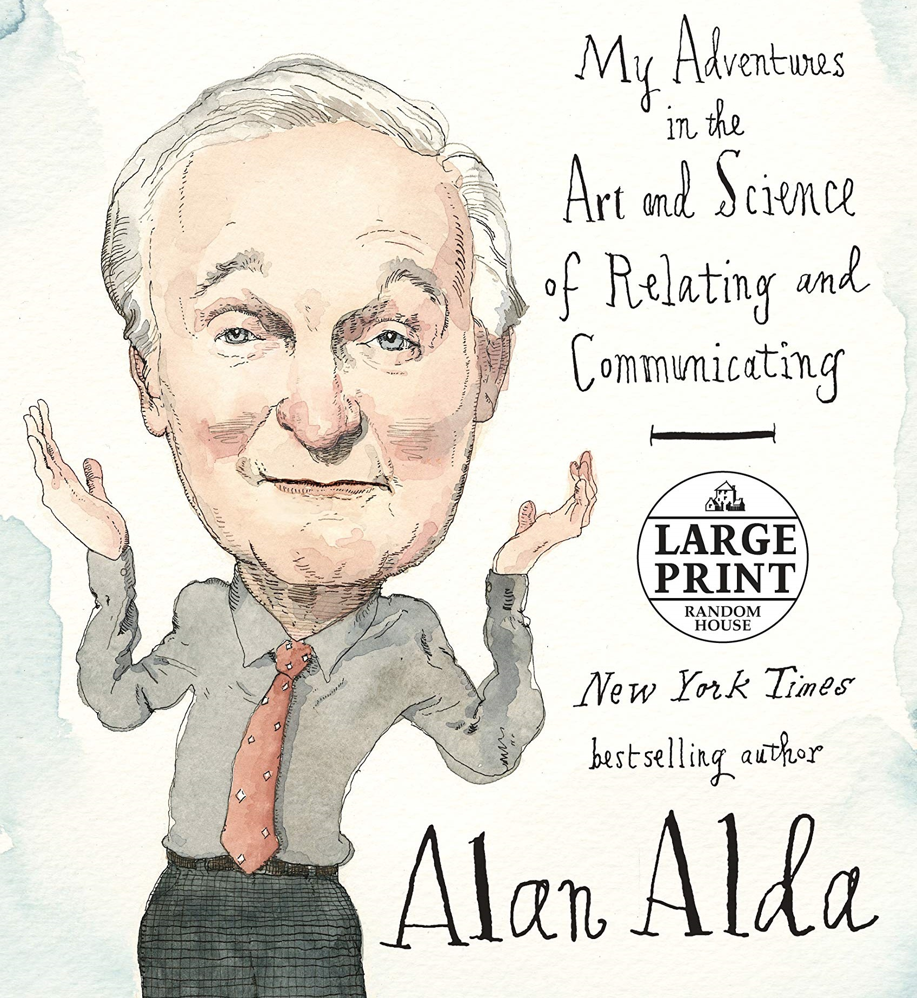
Notes:
For me, any talk on science communication starts here.
Scientific American Frontiers for 11 years

Slide 5
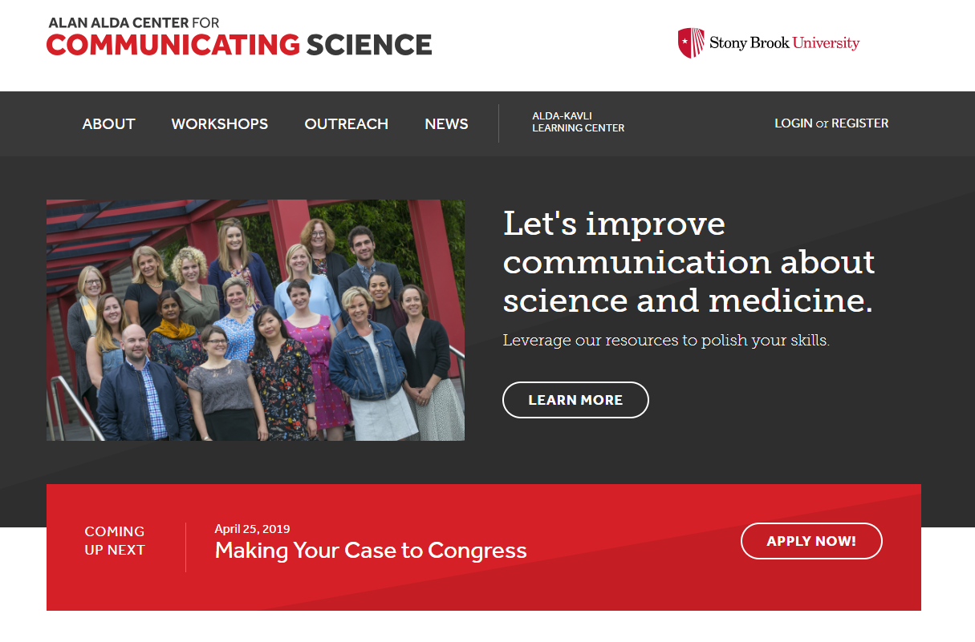

Slide 6
The Story
The Mirror
A Blank Page
Dr. Know-It-All
But Wait…There’s More
The Rant
The Elevator
Notes:
Know your audience.

Slide 7
The Story
The Mirror
Painting a picture
Dr. Know-It-All
But wait…there’s more
The Rant
The Elevator
(Simple, but accurate)
A surgical anastomosis is a surgical technique used to make a new connection between two body structures that carry fluid, such as blood vessels or bowel. It can be created using suture sewn by hand, mechanical staplers and biological glues, depending on the circumstances.
Some of your intestine has gone bad. We have to cut out the bad part and sew the two good ends together.
Notes:
Alan Alda tells a great story about when he got stuck Chile waiting to interview astronomers and became deathly ill with stomach pain. He met a Chilean surgeon while in a lot of pain. Instead of telling him the jargon of what he had, he gave it to him simply in a story. But simple doesn’t mean stupid or incorrect.
Some of your intestine has gone bad, we have to cut out the bad part and sew the two good ends together.

Slide 8
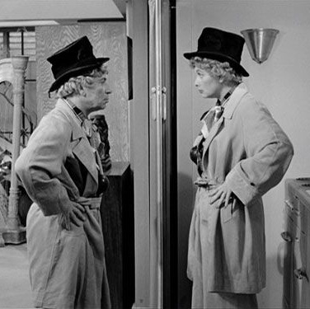
The Story
The Mirror
Painting a picture
Dr. Know-It-All
But wait…there’s more
The Rant
The Elevator
(Pay attention to your audience)
Notes:
Know your audience.

Slide 9
The Story
The Mirror
A Blank Page
Dr. Know-It-All
But wait…there’s more
The Rant
The Elevator
(Help people create a mental picture)
Notes:
Know your audience.

Slide 10
‘A boardwalk stretches into the distance…’

Slide 11
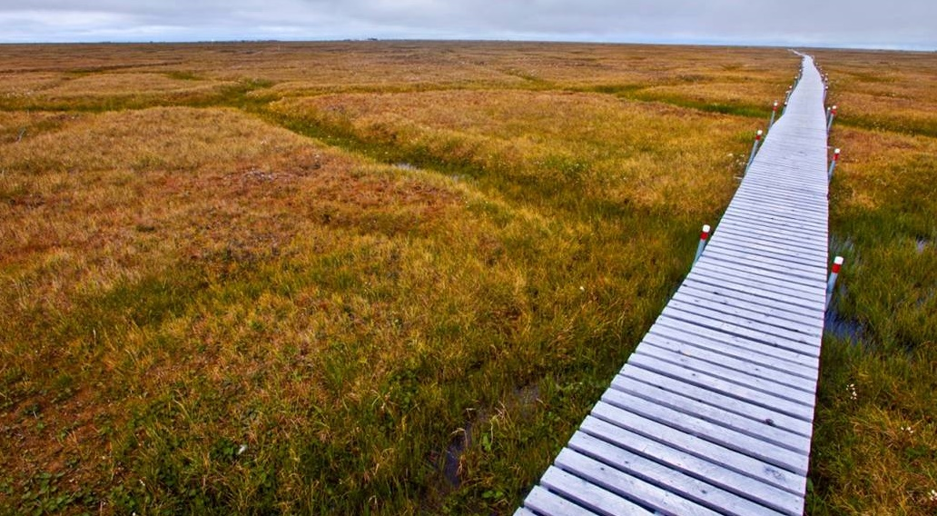

Slide 12
The Story
The Mirror
Painting a picture
Dr. Know-It-All
But wait…there’s more
The Rant
The Elevator
(Adding to the story)
Notes:
Know your audience.

Slide 13
The Story
The Mirror
Painting a picture
Dr. Know-It-All
But wait…
The Rant
The Elevator
(Thinking on your feet)
Notes:
Know your audience.

Slide 14
The Story
The Mirror
Painting a picture
Dr. Know-It-All
But wait…there’s more
The Rant
The Elevator
(Finding the underlying meaning)
Notes:
Know your audience.

Slide 15
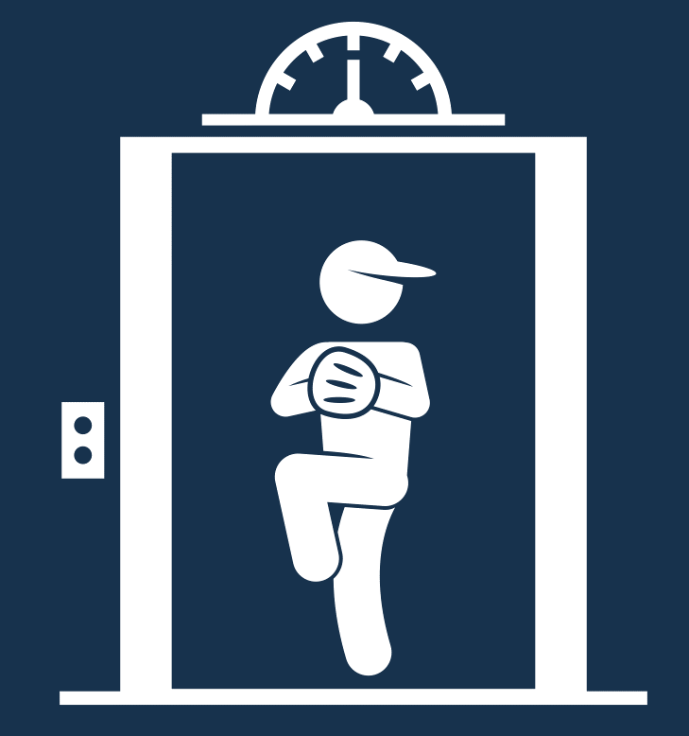
The Story
The Mirror
Painting a picture
Dr. Know-It-All
But wait…there’s more
The Rant
The Elevator
(A short, sweet story)
Notes:
Know your audience.

Slide 16
Scientists
Public
Students
​Climate Change Science Institute at Oak Ridge National Laboratory Cutting-edge · SciComm · Leaders · Vision

Slide 17
How can we improve our communication with other scientists?
Notes:
Alda school
Lunchtime breakout session
Pay attention during other people’s talks
A few easy ways too….

Slide 18
‘A compelling story’

Slide 19
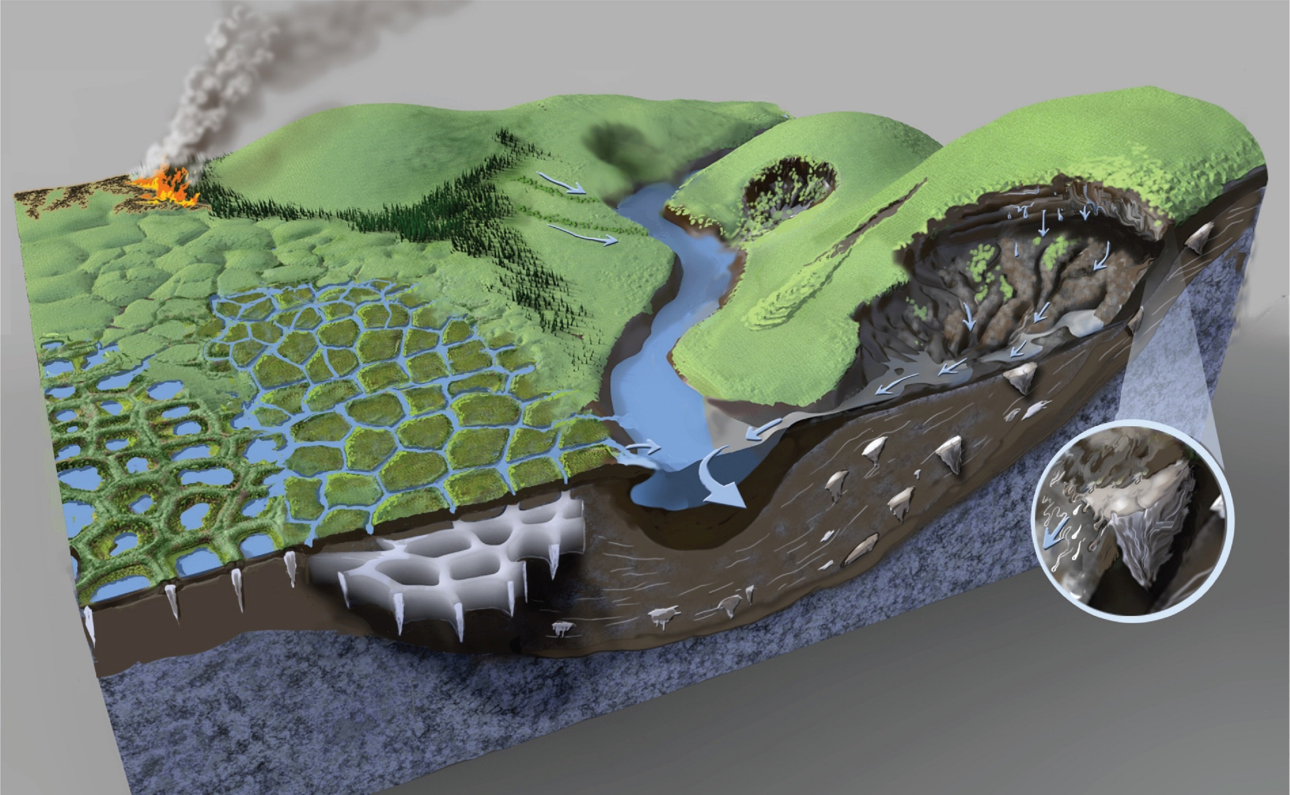
​Schuur and Mack, 2018 Annu. Rev. Ecol. Evol. Syst. 49: 279 - 301

Slide 20
#TwiceasNice

Slide 21
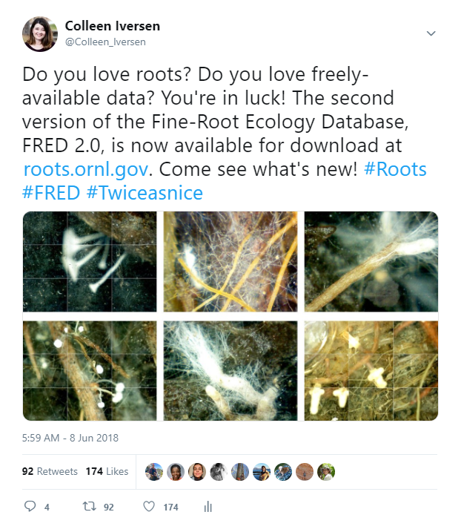
Notes:
Impressions: 23,000 (people saw this tweet)
Total engagements: 800 (people interacted with it)
K Hayhoe’s list

Slide 22
‘Deep roots’

Slide 23
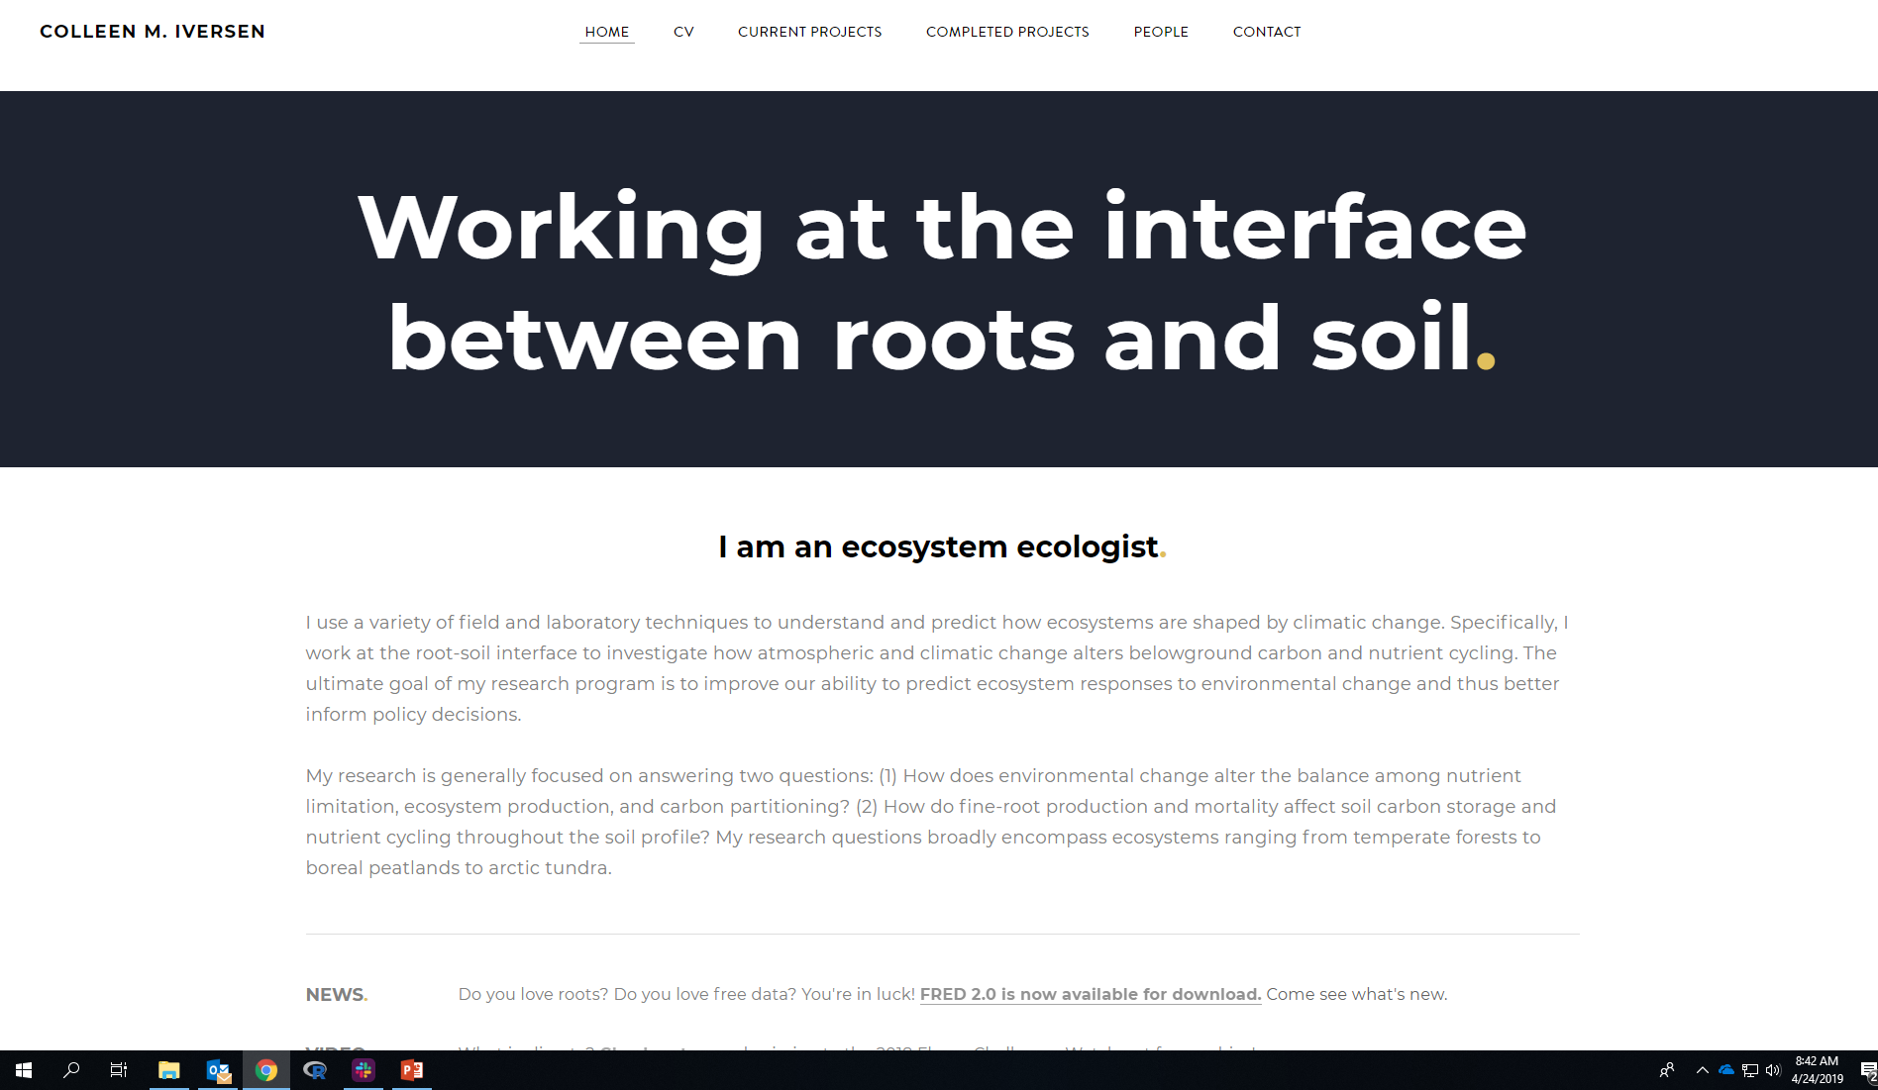
(www.colleeniversen.com)

Slide 24
‘Beautiful winding fingers’

Slide 25
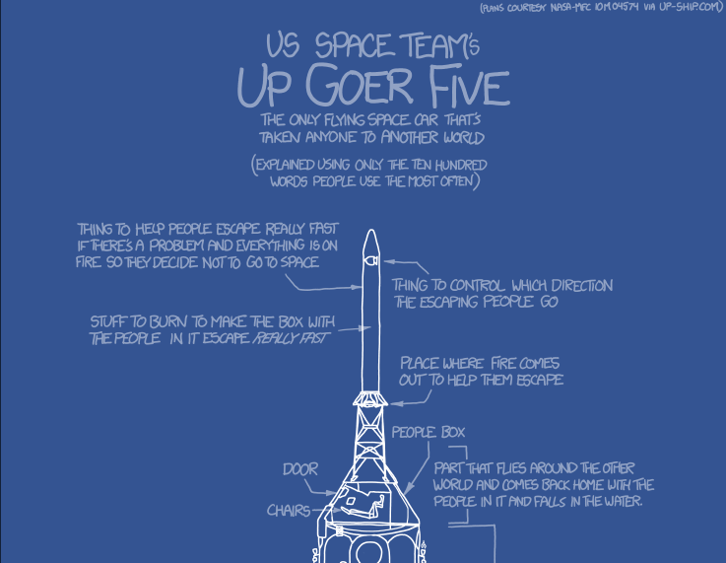
​‘Up Goer Five Challenge’ American Geophysical Union Fall Meeting

Slide 26
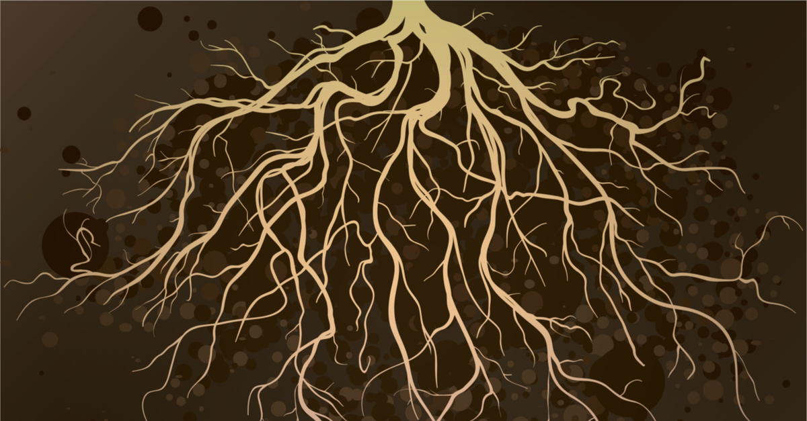
Shutterstock 255851521 Glasscage

Slide 27
Green, living things that cover the world have parts that are under ground.
These parts are important because they get food and water for the green parts we can see.

Slide 28
The parts under ground are beautiful winding fingers that are as fine as the hairs on your head, and they live in the brown, dead matter under our feet.

Slide 29
My friends and I found news on under ground parts growing in different places in the world to better understand how they are the same and how they are different.

Slide 30
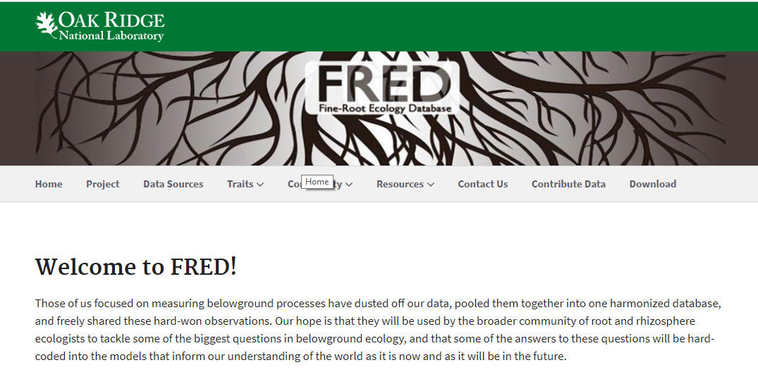
Notes:
‘Throwing parties’ ‘Racing ‘him’ cells’ and ‘Round ‘her’ cells’
Instead of ‘in review’ ‘in being looked at

Slide 31
How can we improve our communication with the public?

Slide 32
‘A green seashore’

Slide 33
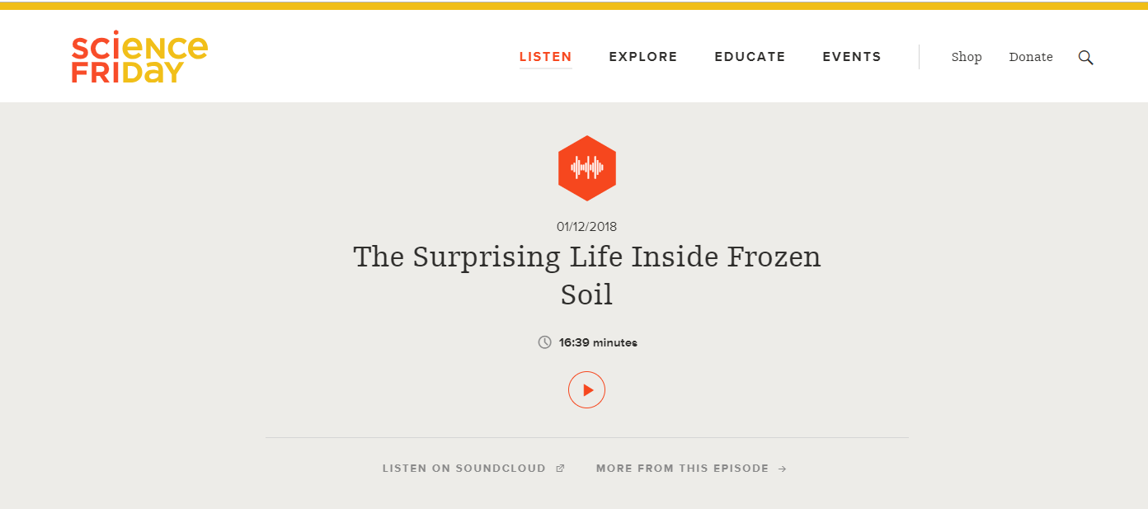
‘The Surprising Life Inside Frozen Soil’
Notes:
Listen to minutes 2:35 to 4:15 on sound cloud: https://soundcloud.com/scifri/frozen-soil-still-teems-with-life
10:20 is different kinds of roots
Matt Wallenstein Colorado State
Tone police….

Slide 34
‘I could take you’ to Barrow, Alaska in the summertime
Look out over the tundra, it would look like a ‘green seashore’
The plants that are there are ‘hugging the ground’ to avoid the harsh wind and cold
Really that’s ‘just the tip of the iceberg’; really all the action in the tundra is belowground
The further the roots ‘dip their toes’ into the soil, the closer they are to that freezing permafrost

Slide 35
‘Do you want me to tell you about robots?’

Slide 36
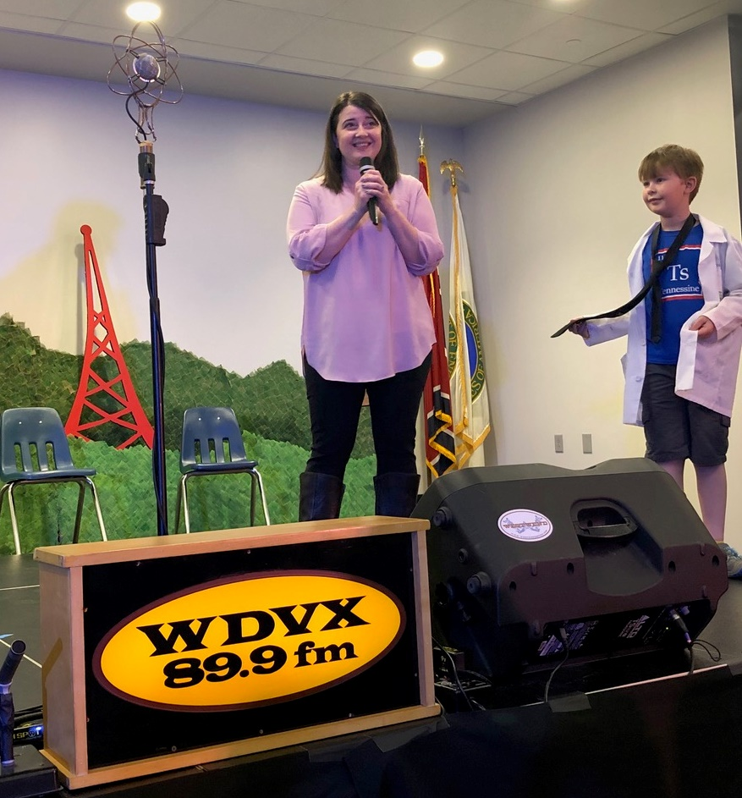
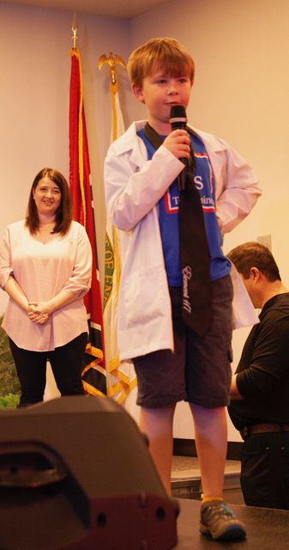
Notes:
Here is the opportunity for the ‘but wait, there’s more’ lesson!
4:02

Slide 37
‘I already just answered that because I jumped ahead of you.’
‘You’re being very relatable Dr. Iversen, which I appreciate!’
‘Do you want me to tell you about robots?’

Slide 38
‘New Voices’

Slide 39
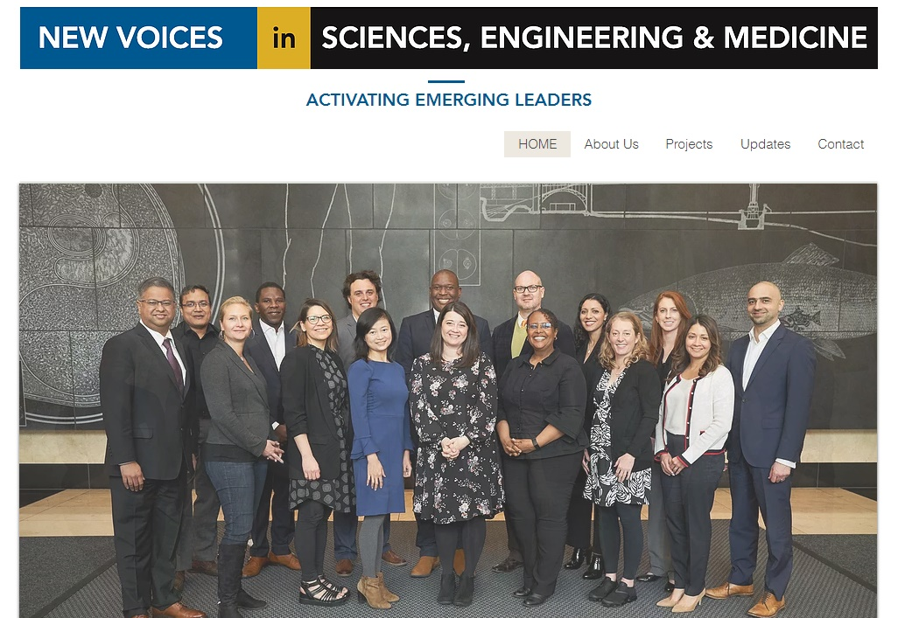
​‘New Voices’ of the National Academies of Science, Engineering, and Medicine https://www.newvoicesnasem.org/
Notes:
In 2018, the National Academies of Science, Engineering, and Medicine (NASEM) launched an initiative designed to bring diverse perspectives from early-career U.S. leaders to important dialogues around how science, engineering, and medicine are shaping the global future. An initial cohort of 18 outstanding STEM professionals—the ‘New Voices’ in Science, Engineering, and Medicine—was given a mandate to provide new perspectives on globally important scientific issues, to improve the communication of scientific understanding, and to advocate for innovative strategies designed to expand the diversity of scientific professionals.

Slide 40
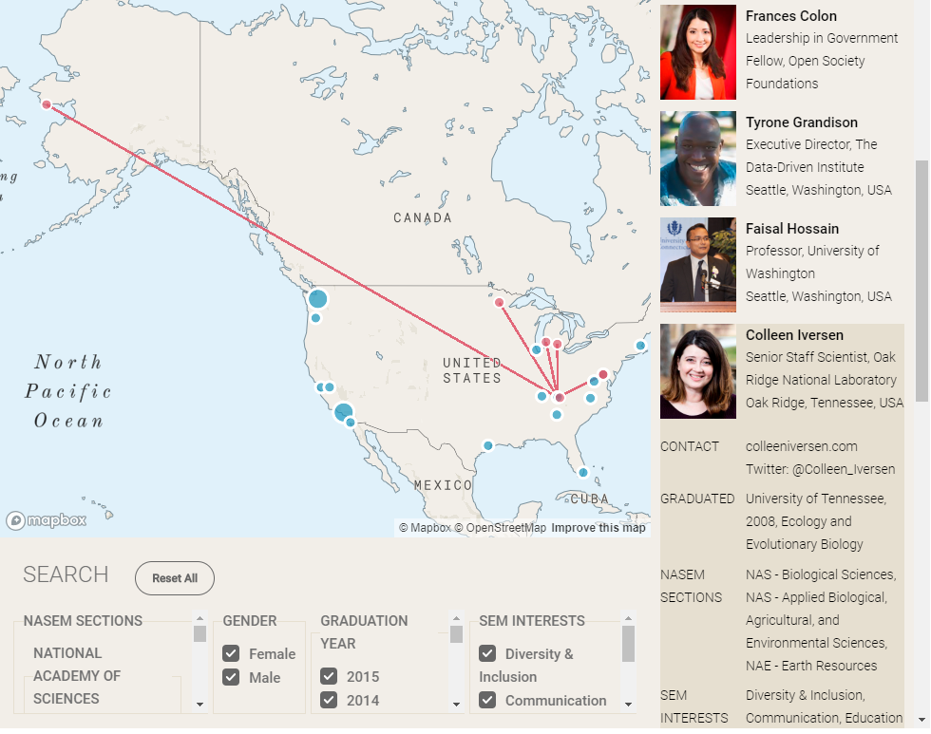
Notes:
New Voices—program, network, etc. NASEM is developing scicomm strategy, CC comm strategy

Slide 41
‘I am a scientist’

Slide 42
I am a scientist.
Notes:
4:10

Slide 43
I am curious.
I walk through a forest, dissatisfied with the dappled light dancing over green leaves. I want to know what is hidden beneath the surface. The rhythmic pulsing of roots being born, living, and dying. They are the life support system for the towering trees above, and the compost for a multitude of creatures, big and small.
Notes:
4:10

Slide 44
I am an explorer.
I look up and catch my breath at the view of the vast and alien landscape around me—it could be another planet. I dig into the tundra, down, down—a few inches that span a millennia—until I reach the permanently frozen soil and have to stop. I wonder, how does the living interact with the dead and decaying? What does the future hold for a frozen ecosystem that is quickly thawing?
Notes:
4:10

Slide 45
I am a child.
My wild blonde curls blow in the wind as I run through the tall grass, kneeling on skinned knees, rushing to flip over one more rock, one more log before we have to go inside for dinner.
Notes:
4:10

Slide 46
I am a mom.
I hold my boys in arms that have been made strong from digging in the dirt. I lean their head on shoulders that have felt the burden of being the new, the first, the only. I rescue a worm from the chubby fingers of a toddler that has dug it from its moist home. I dream of the dark matter that sparks the imagination of a boy with green eyes.
Notes:
4:10

Slide 47
I am the wife of a stay-at-home dad, the daughter of scientists, the great granddaughter of immigrants.
Notes:
4:10

Slide 48
I am a scientist.
Notes:
4:10

Slide 49
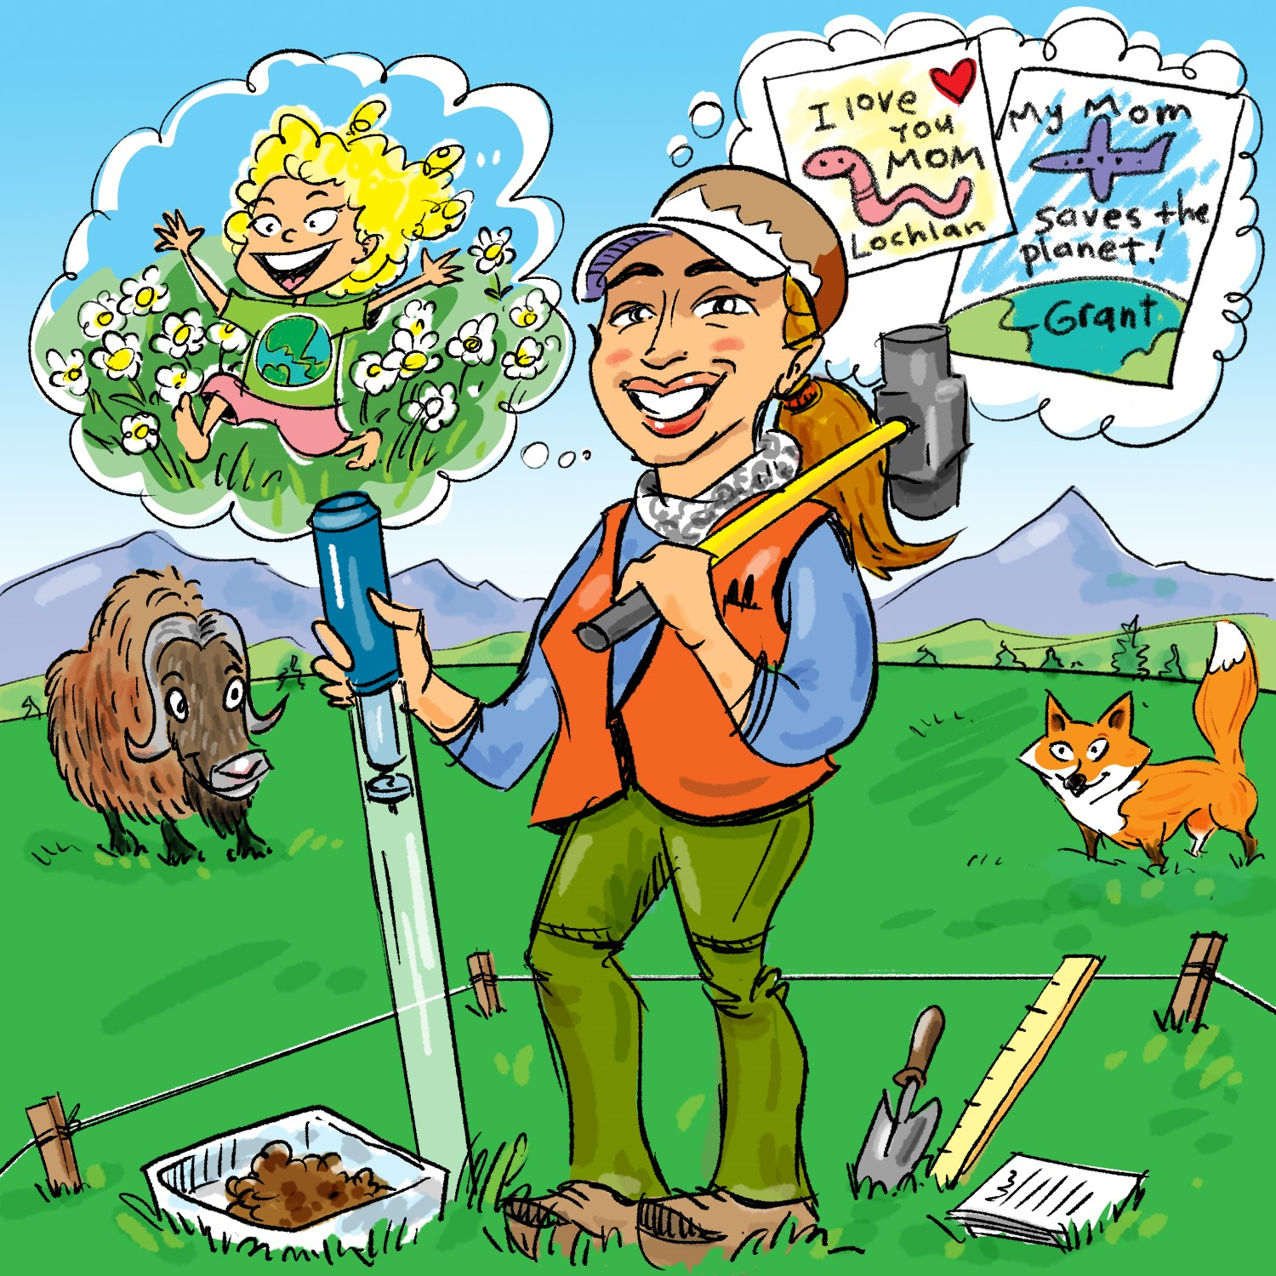
​The New Voices want to hear your story! https://www.newvoicesnasem.org/tell-us-your-story

Slide 50
‘Oh, you’ll go in.’

Slide 51
Colleen Iversen is talking to a tube. “Oh, you’ll go in,” she tells it.
​‘Deep, dank and mysterious’ New Scientist Magazine (Rachel Gross, 21 September 2013)
Notes:
4:10

Slide 52
Dressed in a neon orange vest, khaki trousers and rubber boots that are ankle-deep in squelchy muck, she is pushing a wire mesh cylinder into a bog.
​‘Deep, dank and mysterious’ New Scientist Magazine (Rachel Gross, 21 September 2013)
Notes:
4:10

Slide 53
Ignoring the mosquitoes that swarm around her face, Iversen leans her weight against the tube and gives it one more shove. Shlump! It is swallowed up, and there it will remain for the growing season until Iversen returns to collect a sample of new-grown roots and sludge.
​‘Deep, dank and mysterious’ New Scientist Magazine (Rachel Gross, 21 September 2013)
Notes:
4:10

Slide 54
How can we improve our communication with the next generation of scientists?

Slide 55
‘Watch out for zombies!’

Slide 56
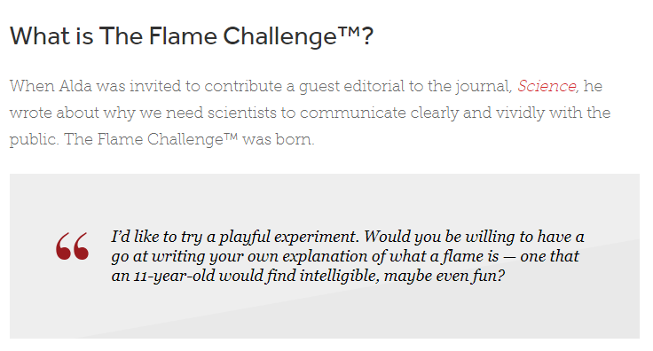
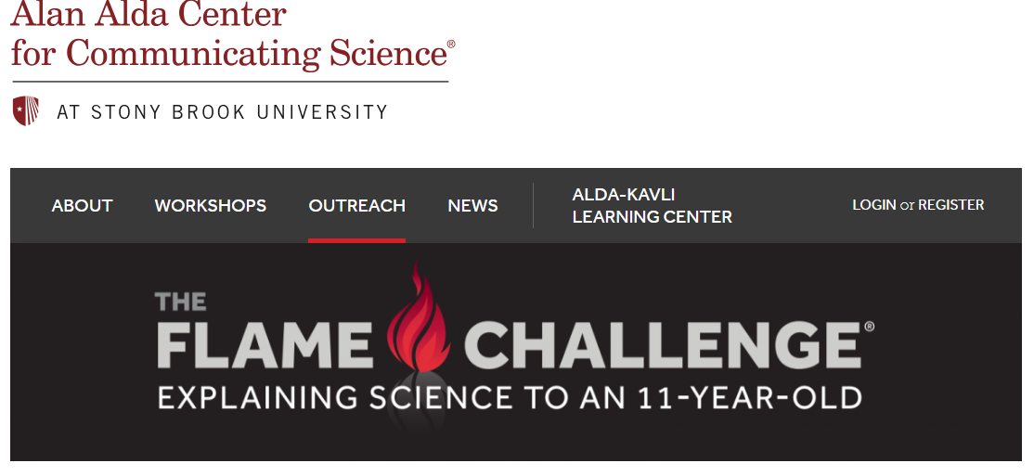
Notes:
Alan Alda Op-Ed in Science

Slide 57
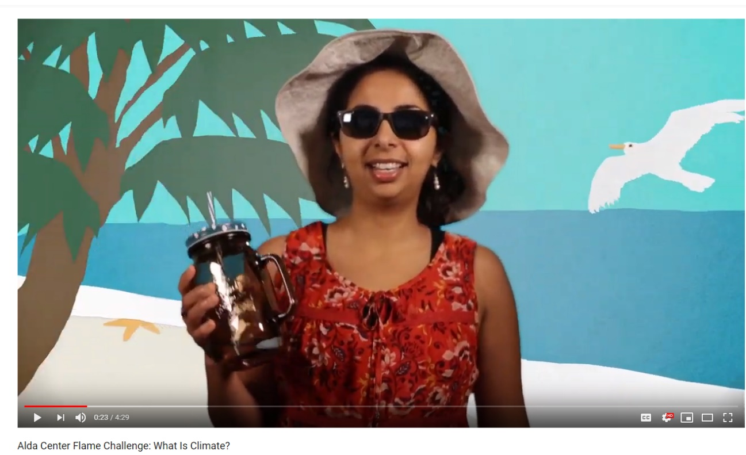
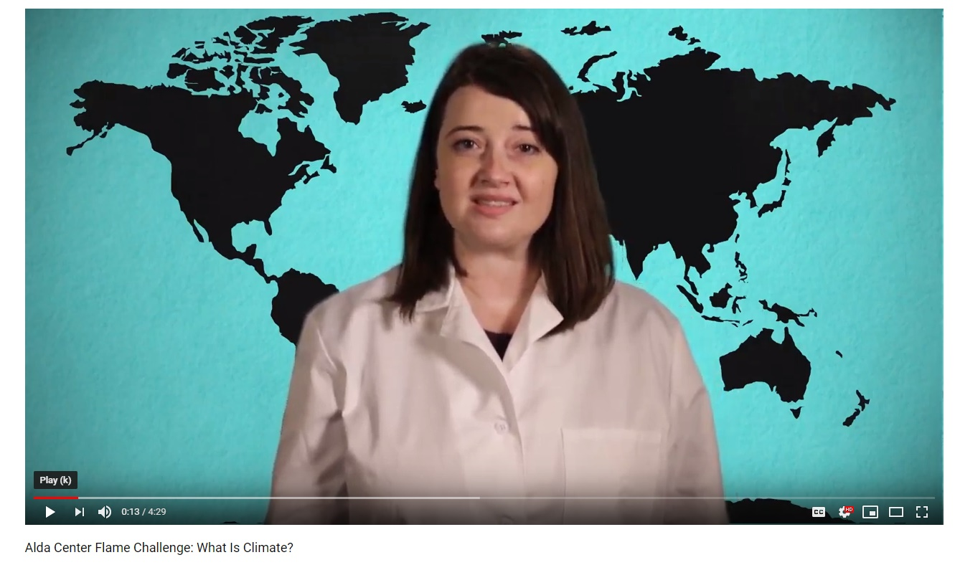
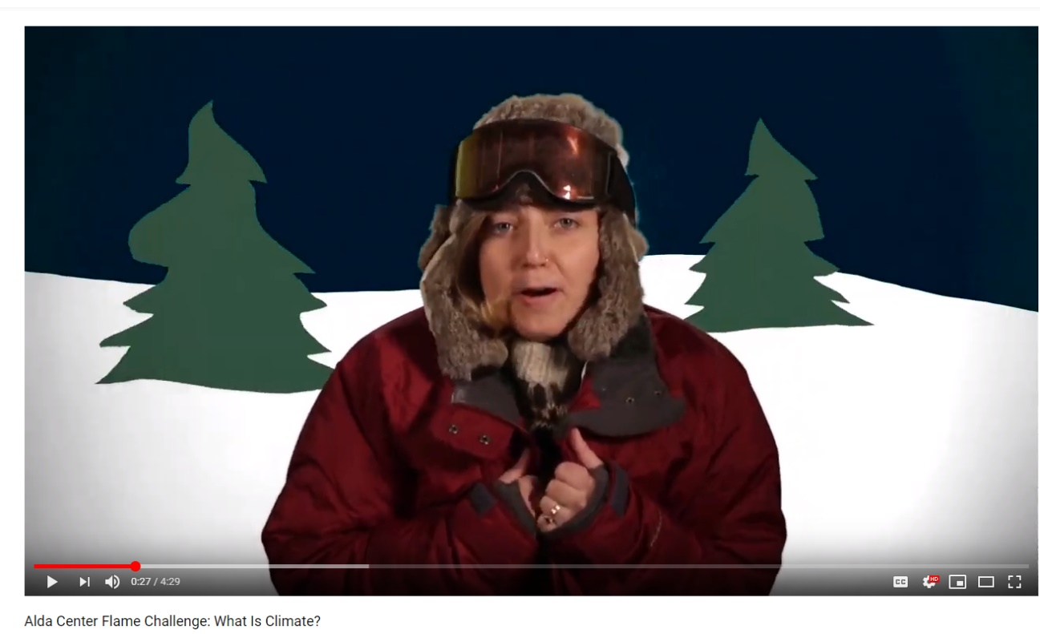
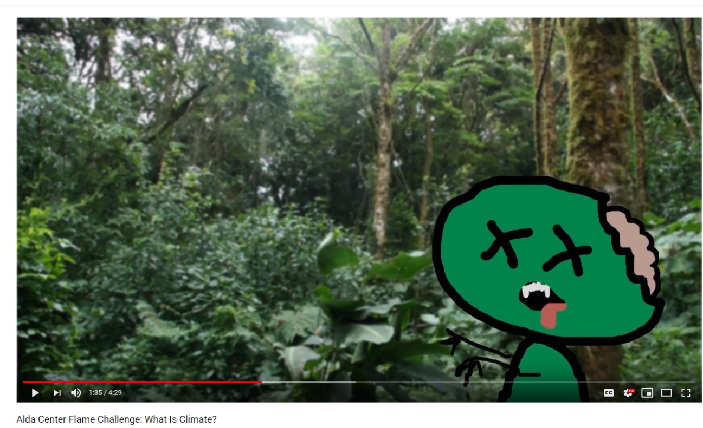
Notes:
Flame Challenge—judged in real time by 11-year olds (quote about math and science)

Slide 59
IT WAS AWESOME!!!!!!!!! I LOVE SCIENCE!!!!!!!!!!
i liked how you related climate to minecraft because there is tons of biomes in minecraft like deserts and cold snowy places it is very creative i loved it
the video was pretty funny at most parts but at some times it could be a little boring.
We didn´t understand what the nature has to do with math.
​‘Real-time feedback from 11-year olds’ Yikes

Slide 60
‘Skype a Scientist’

Slide 61
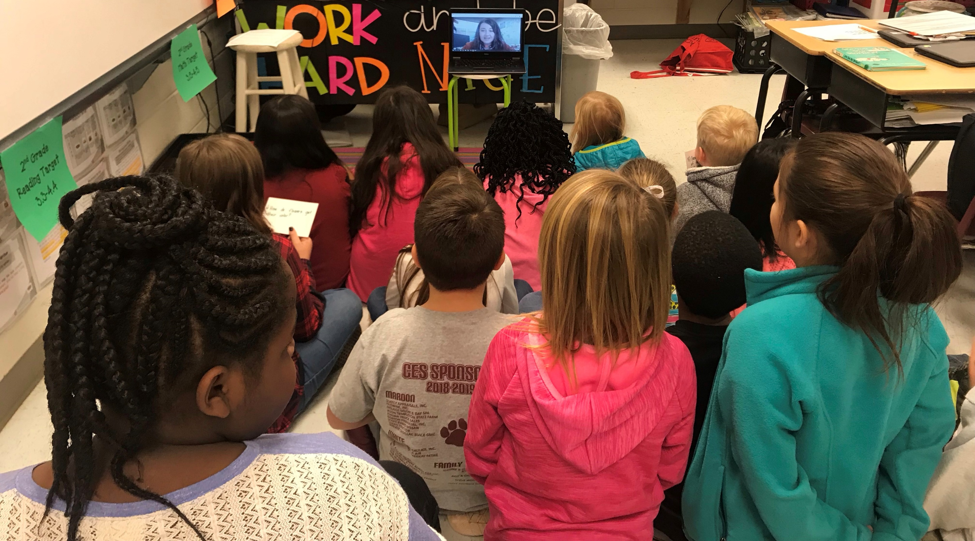
Notes:
Skype a Scientist—stories from these interviews, kids ask the hardest questions, show pictures
Outreach videos

Slide 62
What is climate change?
What is acid rain?
Georgia has had a lot of rain this year and last year. Does that mean our climate is changing?
Which kinds of flowers can you eat?
​‘Central Elementary in Carrollton, GA’ 2nd Grade
Notes:
4:10

Slide 63
‘But wait…there’s more’

Slide 64
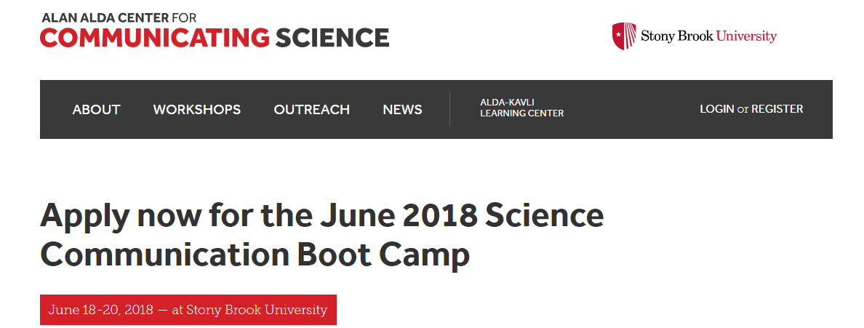
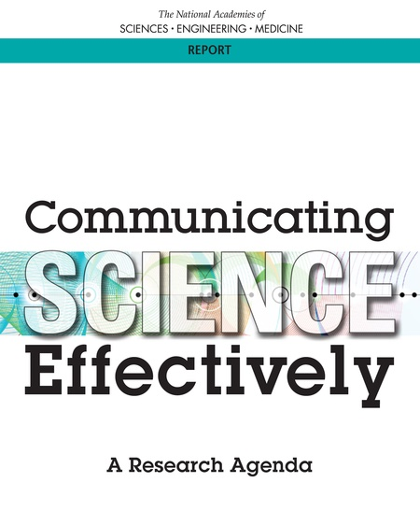
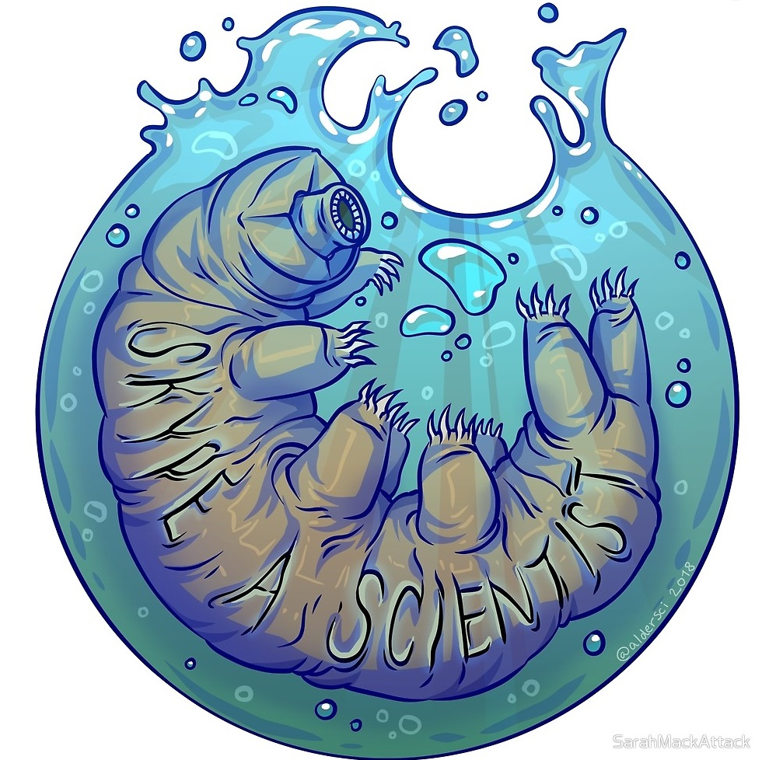
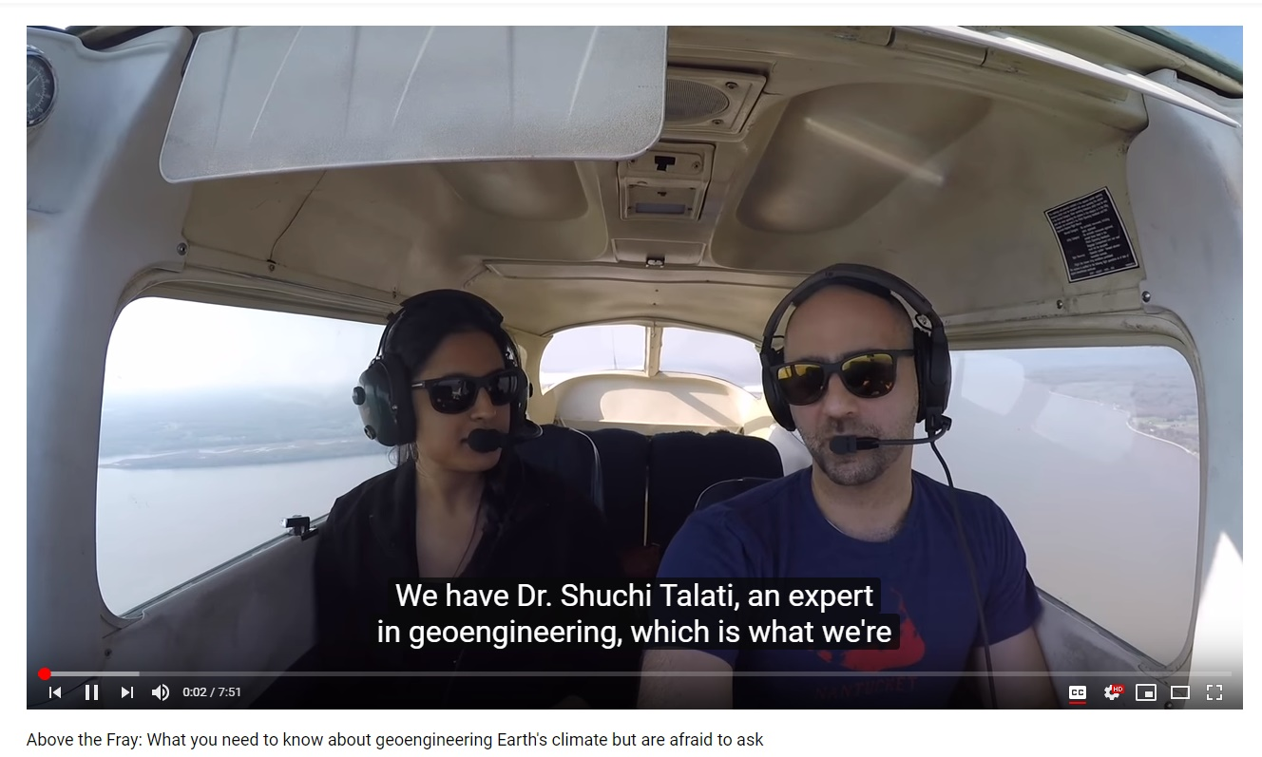
Notes:
Also Alaskan Voices

